Slide 1

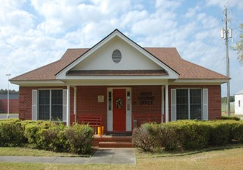

Public Private Venture (PPV) Housing
Plain Language Brief
(Tenant Welcome & Orientation)
Parris Island Military Housing Office 2023 March
Marine Corps Installations Command (MCICOM)

Slide 2
Table of Contents
Section | Topics
Welcome and Background | Welcome; MHO and PPV Partner Contact Information; MHO Services and Responsibilities; PPV Partner Information
Understanding Your Lease | Understanding Your Lease; Fees and Payments; Tenant Responsibilities
Moving In | What to Expect: Move-In and Move-Out; Renters’ Insurance Overview; Tips for Renters’ Insurance, Resident Energy Conservation Program
Home Maintenance | Maintaining Your Home; Window Safety Tips; Maintenance Issues; Types of Service Calls
Your Rights as a Tenant | Tenant Bill of Rights; Dispute Resolution Process Overview; Informal and Formal Dispute Resolution Processes; Dispute Resolution Process Issues
Additional Contact Information | Social Media and Website Links
January 2023
2

Slide 3

Welcome!
The Military Housing Office (MHO) welcomes you to MCRD PARRIS ISLAND where our MISSION is to ensure the MILITARY SERVICE MEMBERS in Public Privatized Venture (PPV) housing are provided with a comfortable, adequate, well-maintained and managed living facilities that shelters them and their families. In addition, provide mediation if needed by resident that complies with fair housing objectives.
This brief is an introduction to your MHO and PPV Partner and includes your rights and responsibilities as a tenant
Atlantic Marine Corps Communities is a privatized company that owns and manages your rental property. The MHO, your government point of contact (POC), will assist you with any housing concerns and serve as your housing advocate
Your PPV Partner now requires you to obtain renters’ insurance as a condition of your occupancy. Renters’ insurance helps protect you and your belongings. Additional information on renters' insurance is found within this brief and is available from your MHO
January 2023
3

Slide 4
Contact Information
MHO Contact Information | PPV Partner Contact Information
Street Address: 402 Boulevard De France Parris Island, SC 29905 | Street Address: 640 Laurel Bay Road Beaufort, SC 29906
Phone: 843-228-2853 843-228-2244 | Phone: Office: 843-846-5300 Maintenance: 877-509-2424
Website: https://www.mcrdpi.marines.mil | Website: www.tc.atlanticmcc.com www.lendlease.com
Facebook/Social Media: (N/A) | Facebook/Social Media: https://www.facebook.com/Tricommand
Email: PARR_SMB_MCRDPI_HOUSING | Email: mthames@tricommand.com
January 2023
4

Slide 5








MHO Services and Responsibilities
Installation Commander:
Mr. James B. Stone, IV
Installation Housing Director:
Mr. Albert Kight Jr.
The MHO is here to assist you with:
Advocacy on your behalf with the PPV Partner
Applications for service members seeking referrals to live in family housing
Home referral services for off-base housing
Fair Housing Act concerns or complaints
Assistance during move-in, move-out, and other inspections performed by PPV Partner at resident’s request
MHO contact for next duty station
Housing questions and concerns
Assistance in the dispute resolution process
January 2023
5

Slide 6


AMCC at Parris Island/Naval Hospital
PPV provides benefits that are not typically offered in community rentals:
Rent cannot exceed the Basic Allowance for Housing (BAH) with dependents rate
No upfront costs including application fees for Service members
No credit history or salary requirements
Basic utilities are included with rent
PPV Project
AMCC housing is conveniently located at Laurel Bay, MCRD Parris Island, and Naval Hospital. Amenities includes pool, playgrounds, RV storage and community center with Wi-Fi access.
PPV Partner
AMCC also has community events, Resident Advisory Boards (RAB) and Department of Defense Education Activity schools (DoDea).
January 2023
6

Slide 7
Understanding Your Lease
Tenants must accept and sign the PPV lease with DoD approved language. The lease includes tenant’s rights and responsibilities. The resident handbook is considered part of the lease. Face-to-face lease signing is available and encouraged, especially if the tenant has questions. DocuSign is the recommended electronic signing option.
In addition to the lease itself, the PPV lease includes several addenda:
Addendum 1 – Electronic Lease Acknowledgement
Addendum 2 – Discounts
Addendum 3 – Community Specific
Addendum 4 – Fitness Center Access
Addendum 5 – Contact Information
Addendum 6 – Tree Swing
Addendum 7 – Community Facilities
Addendum 8 – Unaccompanied Service Member
Addendum 9 – Accessible Adaptable Unit Relocation
Addendum 10 – Satellite Dish
Addendum 11 – Early Lease Termination
Addendum 12 – Mold & Mildew
It is important to read through and understand what you are signing. If you have questions on your lease, contact the PPV Partner
January 2023
7

Slide 8
Fees and Payments
Tenants may be charged additional fees authorized by the lease and the DoN
The following are the fees authorized by the lease and the DoN:
Fee 1 – If a Service Member is Single and living in the Barracks, BAH will not START until they clear the barracks. MHO cannot start the PPV/BAH deduction until BAH starts. Service member’s may move into housing prior to BAH starting and therefore will be will be required to pay 1-3 days out of pocket until BAH actually starts.
Fee 2 – NAVY, If a Service Member is in the Navy, MHO cannot do a PPV/BAH deduction. The allotment system setup for the Navy is with MAC allotment. The allotment is started by AMCC or by the Service member.
The Service member will be requirement to pay out of pocket prior to the
allotment starting. Example, if they move in on the 1st of the month, they will be required to pay for the full month’s rent out of pocket. If they move in on the 15th of the month, they will be required to pay prorated for half month’s rent. The next month’s rent will be paid by the Navy MAC allotment.
It is important to read through and understand what you are signing. If you have questions, contact the PPV Partner and MHO if necessary
January 2023
8

Slide 9
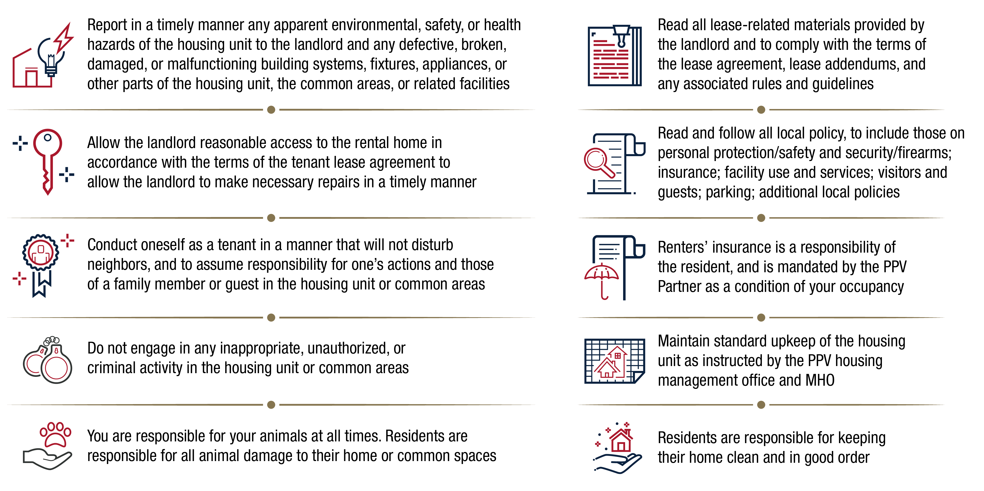
Tenant Responsibilities
Per your lease, you have several responsibilities to fulfill:
January 2023
9

Slide 10
What to Expect: Move-In and Move-Out
MOVE-IN
MOVE-OUT
The Resident:
Tours the home for quality
Accepts home and terms of lease
Signs a lease
AMCC provides:
Walk-through tour of your home
Move-in inspection with checklist
Lease signing and answers to questions
Keys
A survey asking about your move-in experience
MHO provides:
Plain Language Brief and answers to housing policies/questions
MHO Representative at your move-in inspection
Follow-up to check-in with you (15 and 60 day)
Support to resolve any unresolved concerns at move-in
The Resident:
Provides a minimum of 30-day notice to vacate to AMCC
Returns the home in good condition
AMCC provides:
An inspection prior to move-out to assess the condition of your home utilizing the move-in inspection checklist
Appropriate maintenance services and a speedy issue resolution
A final determination of any damages or repairs and associated costs
A move-out survey for you to provide feedback
MHO provides:
Provides answers to questions and issue resolution process
MHO representative at move-out inspection
PCS assistance and MHO contact for your next location
Support on any issues
January 2023
10

Slide 11




Renters’ Insurance Overview
As a condition for occupancy, your PPV Partner will require you to purchase renters’ insurance. If you are unable to provide documentation, the Partner reserves the right to penalize you through additional charges
Renters’ Insurance is NOT part of the rent you pay to the PPV Partner and does not come out of your BAH
What is renters’ insurance?
Renters’ insurance is a policy which protects:
You and your personal property against damage and/or loss
You from personal liability (i.e., financial loss) due to damage to the rental property associated with your actions
Someone that is injured while on the rental property you are occupying
Renters’ insurance will reimburse you for personal property destroyed by a fire. If you accidentally set fire to someone else’s property, the personal liability provision will help reimburse the cost of their damaged belongings
Renters’ insurance typically protects items stolen after a break-in at your rental property, or even items stolen outside of your rental
Damage to your possessions from a burst water pipe is typically covered under renters’ insurance
Personal liability coverage is part of a standard renters’ insurance policy. It may help pay for another person's medical bills if you're found legally responsible for their injuries
January 2023
11

Slide 12




Tips for Renters’ Insurance
For more information on renters’ insurance, ask your MHO for a copy of the Tenant Guide to Renters’ Insurance. The MHO can assist you with questions, while the Legal Services Support Section (LSSS) will assist you in understanding policies
The National Association of Insurance Commissioners indicates the average renters’ insurance policy costs between $15 to $30 per month. *Cost may vary depending on your location, choice of deductible, and coverage amounts
Make sure you know what your policy covers. Insurance terms and conditions vary by provider. Be sure to read your insurance policy carefully to understand what may or may not be covered. For example, a liability policy may not cover structural damage from personally owned appliances
Renters’ insurance is widely accessible and may be available through your car insurance company. Make sure to ask about any discounts and bundling options
Don’t Waive the Liability Coverage! Your insurer will help cover the costs if you’re held responsible for injuring another person or damaging another person’s property, including your rental property. The typical renters’ insurance policy offers $100,000 in liability coverage
January 2023
12

Slide 13

Resident Energy Conservation Program (RECP)
RECP is a PPV Housing Program that promotes energy conservation through personal awareness and responsibility. The program was temporarily suspended in February 2020 to address tenant concerns. All services are working with DoD to improve RECP. AMCC has not elected to implement RECP at Parris Island/Naval Hospital
How the Program Works
Each home is metered for utilities. You are to encourage conservation and tenants receive a monthly statement to inform them of their usage.
BAH/rent includes an amount for utilities
Average utilities usage is determined by house type
Tenants that use more receive a bill for the amount over “average” usage, and if they use less they receive a credit for the amount conserved
January 2023
13
Notes:
The Navy and Marine Corps are issuing new RECP policies that require home meters and wiring to be certified as accurate and define the authorized methods for determining the normal utility usage allocation for PPV tenants

Slide 14



Maintaining Your Home
Please be aware of local guidance and report maintenance issues immediately to your PPV Partner
Promptly clean kitchen counters and dispose of food debris
Keep food in air-tight containers
Clear outside doorways and windows of leaves and dirt
Check your toilets and faucets for leaks
Use exhaust fans in bathrooms and laundry rooms
Report leaks and maintenance issues immediately
Check drains and keep them clear
Check your filters per directions by your PPV Partner
Clean and monitor major appliances
Check and change batteries for smoke/CO detectors per directions by your PPV Partner
January 2023
14

Slide 15


Window Safety Tips
Windows are among the top 5 hidden hazards in the home. Before opening a window, know the risks they pose to children
Window Safety Tips
All windows above the first floor should have a Child Fall Hazard warning sticker
Do not rely on screens to prevent a window fall
Only open windows that are out of reach if you need ventilation
Child Safety Tips
Encourage children to play in the center of the room and away from open windows
Pay close attention to furniture, or anything children can climb near open windows
Keep corded blinds as short as possible to keep them out of the hands of small children
PPV Partners and MHOs are currently working towards installing safety measures to windows with sill heights of 24 inches or lower in homes. Windows with sill heights higher than 24 inches may not have secondary safety devices
January 2023
15

Slide 16
Maintenance Issues
How to Report Maintenance Issues
Report maintenance issues (maintenance emergencies, trouble calls, safety concerns, compliance issues) right away by contacting your PPV Partner
For an emergency, urgent, and routine maintenance, call: 877-509-2424
Web Portal: https://www.rentcafe.com/residentservices/Atlantic-marine-corps-communities_at_tri_command/userlogin.aspx
Submitting and Tracking Work Orders
RENTCafe.com helps you save time and manage your new rental effortlessly, from anywhere. Log into your Resident Portal, make and keep track of rent payments, maintenance request, and lease renewals.
Submit routine service request and view current work order status.
Contact your PPV Partner if you have concerns on maintenance, work orders, repairs, or services
January 2023
16

Slide 17
Types of Service Calls
Type of Service Call | Description | Examples | Response Time
Emergency | Critical safety, life threatening issues Resident with a medical requirement for stable temp levels | Gas leaks Fire Power outage Sewage back-up Flood No toilet available for use Refrigerator inoperable | 30-minute initial response 1 day to complete emergency work Available 24/7/365
Urgent | Habitability issues | Broken window Garage door inoperable Kitchen sink back-up Lights flickering or non-working light-fixtures Presence of mold/mildew | 4-hour initial response 1 business day to complete work
Routine | Convenience Unit care issues | Single burner inoperable Repair screens Light bulb replacement | 1 working day initial response 1 business day to complete work
January 2023
17

Slide 18
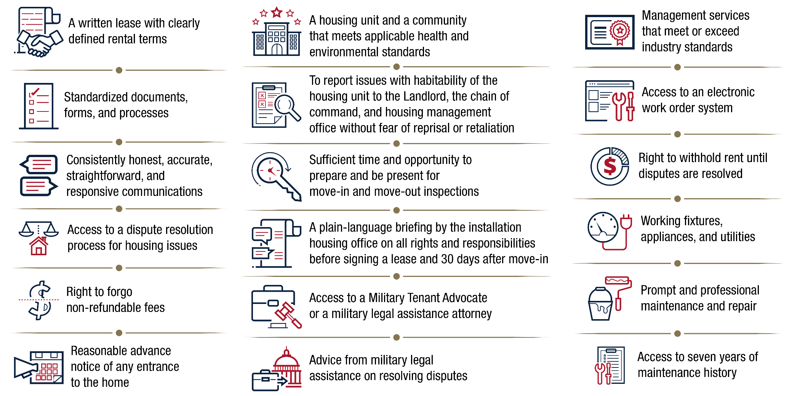
Tenant Bill of Rights
In 2020, laws were passed to assure PPV military residents’ basic rights. MHO will provide residents with a full Tenant Bill of Rights for review
January 2023
18

Slide 19






Dispute Resolution Process Overview
Active-duty Service Members and their families living in PPV Housing have access to the Dispute Resolution Process (DRP), ensuring prompt and fair resolution for housing issues. Your MHO serves as your advocate throughout the informal and formal DRP
You can initiate the DRP to address lease and property issues such as:
Maintenance and repairs
Rental Payments
Fees and Charges
Displacement Rights
Lease Termination
Inspections
The DRP has two components: an informal and formal process.
Informal DRP
The informal DRP is a process in which you work directly with the PPV Property Manager to resolve your dispute. The PPV PM has the opportunity to address your concerns at all management levels.
Formal DRP
The formal DRP is a standardized, objective process that allows for independent investigation to settle the dispute. The full process takes 30-60 days.
January 2023
19

Slide 20




Informal Dispute Resolution Process
The Dispute Resolution Process starts with an informal process of communication between you and the PPV Property Manager (PPV PM). The informal DRP is the first step you should take to resolve your lease and property concerns
If you find a problem at the property where you currently reside, contact your PPV PM so they can take steps to properly resolve the issue
Elevate to the PPV Regional Manager if the action taken is unsatisfactory
If the PPV PM or Regional Manager does not resolve the issue, contact the MHO and inform them of the problem at your property. The MHO may investigate the issue
If you are not satisfied that your housing issue has been solved, your MHO will provide you with the Request Form for DRP, initiating the Formal Dispute Resolution Process
January 2023
20

Slide 21

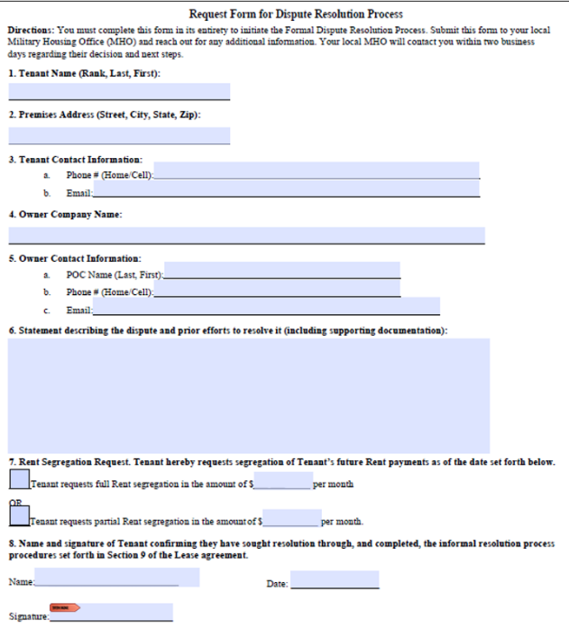


Formal Dispute Resolution Process
You must first attempt to resolve your issue through the informal DRP before you can initiate the formal DRP
  1. Complete the Request Form
  Complete the Request Form and submit it to the MHO, who will validate the form
Completing the Request Form
You can obtain the Request Form from your MHO. You must fill out the form in its entirety. The MHO will determine your eligibility
  2. Participate in the Inspection
  If your issue is an unresolved property concern, the MHO will schedule an inspection with you and your PPV Partner
  3. Cooperate with the Investigation
  The Independent Investigator will review all records and conduct interviews as necessary
  4. Recommended Action Issued
  Send recommendation to Regional Commander. If you disagree with the Commander’s recommendation, submit a rebuttal
  5. Final Decision Issued
  Regional Commander will consider your rebuttal and provide you a final decision on the dispute
To explore the DRP further, please visit the Marine Corps MHO Website (https://bit.ly/3n2zyGe)
January 2023
21

Slide 22
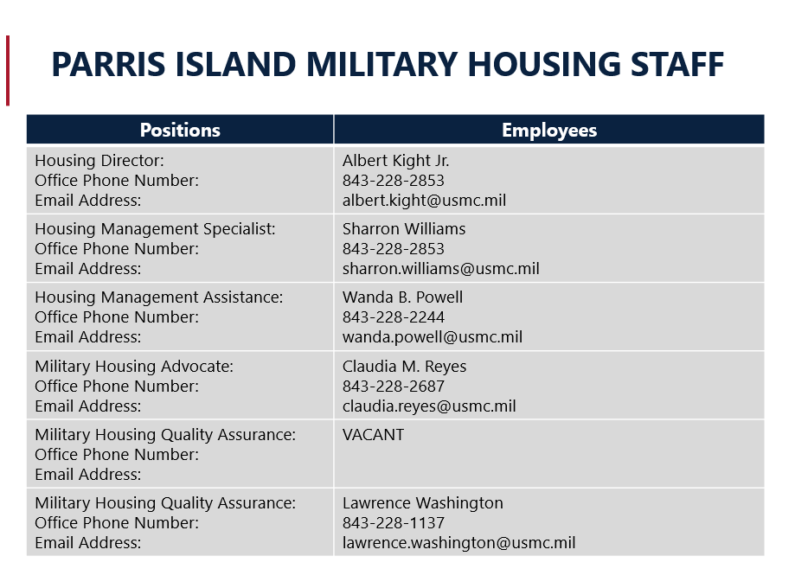

Slide 23
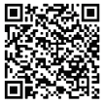
Connect with Marine Corps Housing
https://www.mcrdpi.marine.mil
For information on Marine Corps Housing policies, visit: https://bit.ly/3n2zyGe
January 2023
23

